Slide 1
IT architecture diagrams kit Version 1

Slide 2
About this kit
This kit is a living document that will be updated on an ongoing basis. Please check for updates here prior to each use of this kit to ensure you are using the latest version.
This kit is built using the IBM presentation template.
This kit is meant for creating IT architecture diagrams using the SDS metamodel, but it can be used as a starting point for other types of technical diagrams.
PowerPoint has limitations when drawing diagrams. This kit includes variations of the same elements meant to reduce time spent reproducing diagrams guidelines.
When creating a diagram, find the element closest to your needs, copy it and customize it.
Some text alignments will work as expected automatically as you type, but often you will need to manually adjust the elements to keep the diagram neat.

Slide 3
Support
Relevant links:
Technical diagrams guidance
IT Architecture diagrams guidance
For questions, please use the slack channel:
#it-architecture-diagrams
PowerPoint has limitations when drawing diagrams. This kit includes variations of the same elements meant to reduce time spent reproducing diagrams guidelines.
When creating a diagram, find the element closest to your needs, copy it and customize it.
Some text alignments will work as expected automatically as you type, but often you will need to manually adjust the elements to keep the diagram neat.

Slide 4
Color
Primary colors
Secondary colors
Core
Red 70 #a2191f | Red 50 #fa4d56 | Red 10 #fff1f1 | White #ffffff
Magenta 70 #9f1893 | Magenta 50 #ee5396 | Magenta 10 #fff0f7
Purple 70 #6929c4 | Purple 50 #a56eff | Purple 10 #f6f2ff
Blue 80 #002d9c | Blue 60 #0f62fe | Blue 10 #edf5ff
Cyan 70 #00539a | Cyan 50 #1192e8 | Cyan 10 #e5f6ff
Teal 70 #005d5d | Teal 50 #009d9a | Teal 10 #d9fbfb
Green 80 #044317 | Green 60 #198038 | Green 10 #defbe6
Cool Gray 70 #4d5358 | Cool Gray 50 #878d96 | Cool Gray 10 #f2f4f8
 | Black #000000
The color palette shown here is a subset of the full IBM Design Language color palette.
Use primary colors for outlines, side bars, color blocks and connectors.
Use secondary colors only for fills.
Use alert colors only for badges.
For accessibility reasons, never rely on color alone to convey meaning.
Limited-use
 | Yellow 50 #b28600 | Yellow 10 #fcf4d6 | White #ffffff
 | Orange 50 #eb6200 | Orange 10 #fff2e8
Alert
Red 60 #da1e28 | Green 50 #24a148 | Orange 40 #ff832b | Yellow 30 #f1c21b

Slide 5
Color: Recommended color key
Whilst color can be used to convey any meaning that the architect wishes, normally it is recommended that it is used to represent the domain of an element—e.g. Red for a security component. This is illustrated here as the recommended color key.
Always include the colors used in the legend, even when the recommended color key is used.
Actor Black
Security Red 50
DevOps Magenta 50
Application Purple 50
Data store Blue 60
Network Cyan 50
Management Teal 50
Virtual Private Cloud Teal 70
Compute Green 60
Others Gray 50

Slide 6
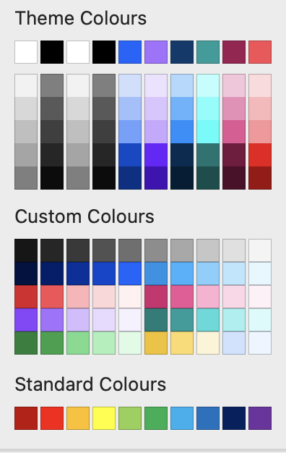
Custom colors
Custom colors for diagrams are available for use in the color drop-down menu.
To apply one of these colors to your elements, do any of the following:
Use the dropdown menu and select the color of your choice.
If the color you need is not present in the palette, copy the HEX value from the color page and paste into the color picker tool.
Use the eyedropper tool.

Slide 7
Legend
Always include a legend to identify how you have made use of visual techniques, like Colour, Shape, or Style.
Actor
Actor
Security
Logical node
DevOps
Prescribed node
Application
Logical component
Data store
Prescribed component
Network
Logical location
Management
Prescribed location
Virtual Private Cloud
Zone
Compute
Subsystem
Others
Style 1
Style 2
Style 3
Removed

Slide 8






















Examples
Public
network
IBM Cloud
Enterprise
network
Region 1
VPC A
User
Zone 1
10.10.0.0/18
Zone 2
10.10.0.0/18
Classic
infrastructure
Enterprise user directory
Subnet: 1
10.10.10.0/24
Frontend ACL
Public
Load
Balancer
Subnet: 3
10.20.30.0/24
Frontend ACL
Internet
Public
Gateway
Transit
Gateway
Enterprise
User
Frontend security
VSI 1
Type: Dedicated
OS: Redhat 8.x
Profile: Balanced bx2-2x8
vCPUs: 2
RAM: 8GiB
Bandwidth: 4 Gbps
VSI 3
Type: Dedicated
OS: Redhat 8.x
Profile: Balanced bx2-2x8
vCPUs: 2
RAM: 8GiB
Bandwidth: 4 Gbps
Floating IP
VPN
connection
VPN Gateway
Subnet: 2
10.10.20.0/24
Backend ACL
Subnet: 4
10.20.40.0/24
Backend ACL
Direct
Link
Enterprise
applications
Private
Load
Balancer
Backend security
VSI 2
Type: Dedicated
OS: Redhat 8.x
Profile: Balanced bx2-2x8
vCPUs: 2
RAM: 8GiB
Bandwidth: 4 Gbps
VSI 4
Type: Dedicated
OS: Redhat 8.x
Profile: Balanced bx2-2x8
vCPUs: 2
RAM: 8GiB
Bandwidth: 4 Gbps
User
Implicit
Router
Enterprise
data
Data store
Security
Network
Applications
Compute

Slide 9
Elements
All model elements defined in SDS have associated visual representations. They can each have a basic fixed shape to allow for easy recognition, but can vary in color, border style, and optionally incorporate an icon to convey further information.
The main elements used in architecture diagrams:
Target IT system: The system being modelled and engineered
Actor: An external IT system or a user interacting with the target system
Component: A modular unit of functionality, which makes this functionality available through an interface
Node: A collection of deployment units in a location
Deployment unit: Non-functional aspects of a component
Subsystem: Any subset of the model elements and element relationships of a system
Location: A group representing a geographical area or position
Zone: A group aggregating a number of model elements with a common set of values for a specific non-functional requirement

Slide 10
Elements: groups
Prescribed location
Prescribed location
Zone on one line
Subsystem on one line
Child
Child
Child
Child
Prescribed location
Text on two lines
Prescribed location
Text on two lines
Zone
Text on two lines or more
Subsystem
Text on two lines or more
Child
Child
Child
Child
Prescribed location
Text on exactly
three lines
Prescribed location
Text on exactly three lines
Zone on one line
Subsystem on one line
Child
Child
Child
Child
Zone
Text on two lines or more
Subsystem
Text on two lines or more
Child
Child

Slide 11








Elements: deployment units
Data DU
Presentation DU
Execution DU
Installation DU
Data Technical DU
Presentation Technical DU
Execution Technical DU
Installation Technical DU

Slide 12
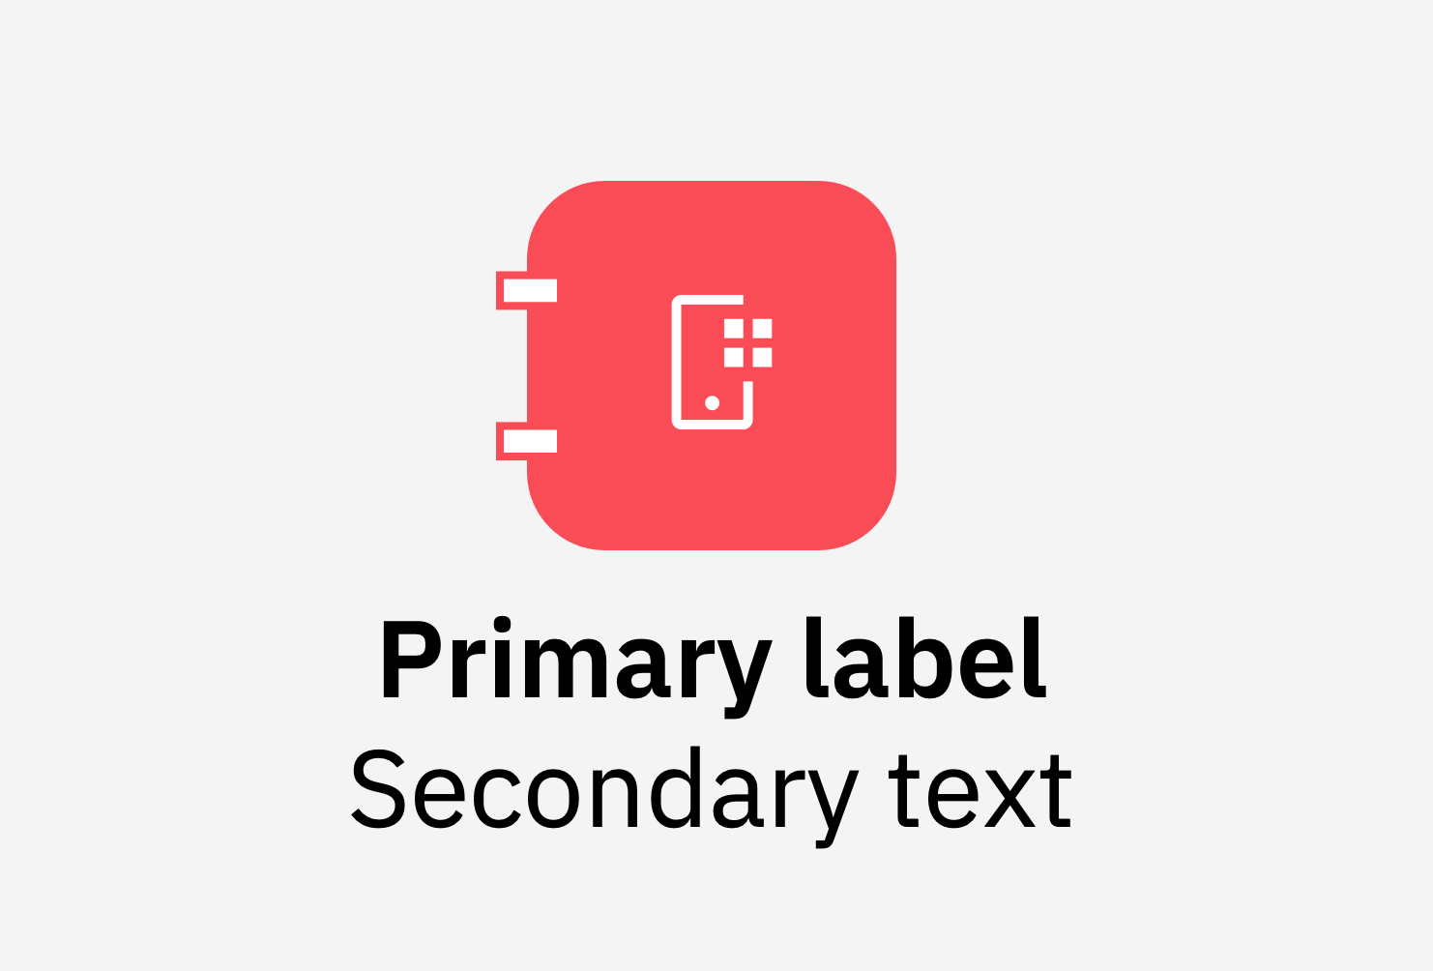
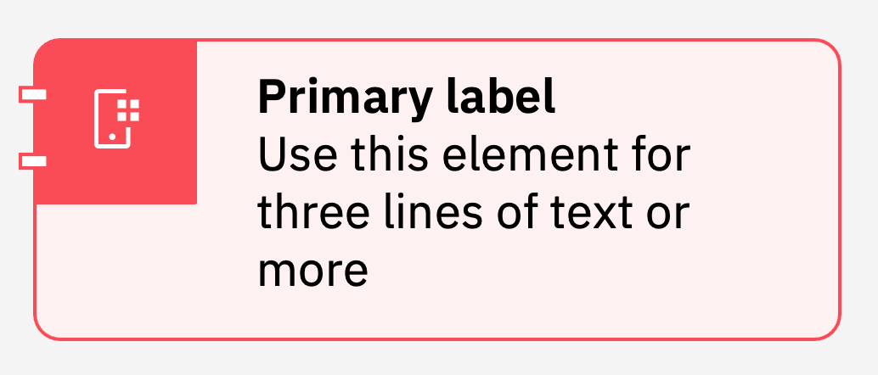
Element anatomy
Color block
Icon
The shape is 48px. It has a fill and a 1.25pt outline.
The icon is 20px. Its color can be edited from Black to White using Shape Fill.
Side ticks are only present in components. The outline color should match the element, the fill should always stay White.
The text is 14pt, Semibold for the primary label, Regular for secondary text.
Do not scale the color blocks, icons or ticks, alter the roundness or change the spacing. You can replace the icon, edit the text and change the colors.
Some elements are grouped; if you need to edit them you may need to ungroup them, edit the individual parts, and regroup them.
Side ticks
Text
Icon
Text
Shape
Color block
Side ticks

Slide 13
Editing elements
Most elements in this kit are groups. There are two possible ways of editing them:
Ungroup the element, edit the individual elements, regroup it.
Select the group then click on the element you want to edit.
When editing labels, make sure you pick the element corresponding to your required text length. If your text have a different number of lines, you may need to manually edit the padding.

Slide 14
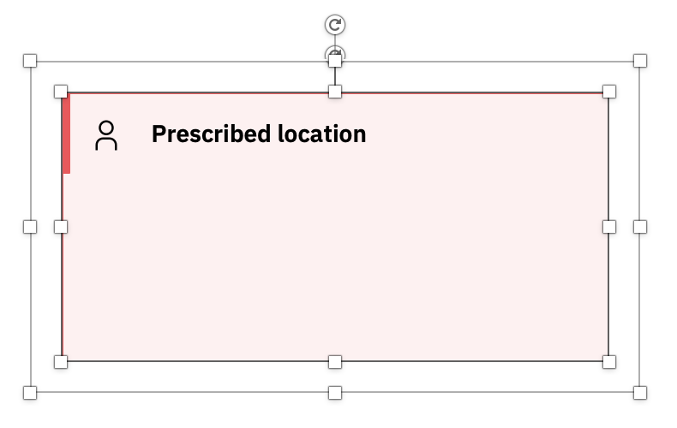
Scaling elements
Layering elements
1. Make sure the inside bounding box is highlighted by double clicking on the inside shape.
2. Drag the bottom left corner to scale to needed size.
When you nested elements, each inner element should have about 16px buffer on each side. Alternate white and light color fills for better readability.
Prescribed location
Prescribed location
Prescribed location
Prescribed location
Double click this line
Drag from this corner
IT architecture diagrams kit |

Slide 15
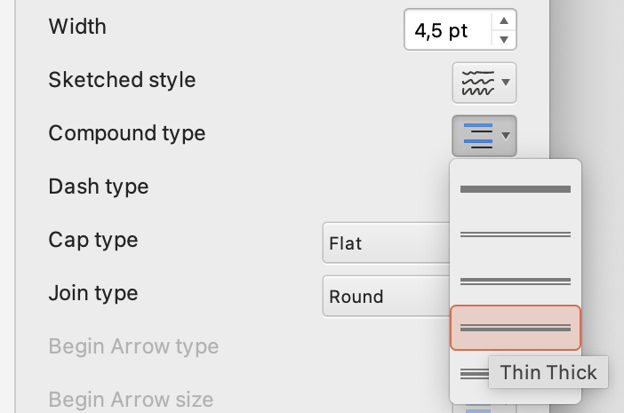

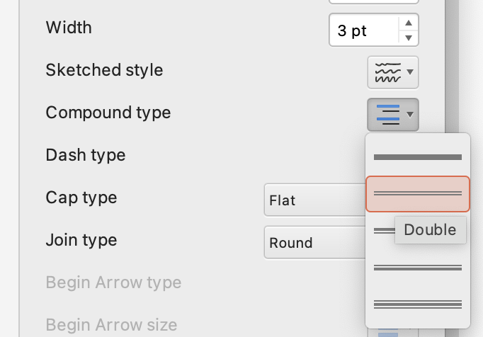

Style: instructions Double line
These are the settings to use for creating the various styles. It is recommended to work with the outlined elements and not the filled elements when using these styles in PowerPoint.
Double line is usually used to signify that an element was added.
For filled elements, set the outline as compound, thin thick, 5pt
Actor
Secondary text
Prescribed node
Without an icon
For outline elements, set the outline as compound, double, 4pt
Actor
Secondary text
Prescribed node
Secondary text
For elements using a color block under the icons, the outline for the color block needs to be solid, 2pt
IT architecture diagrams kit |

Slide 16
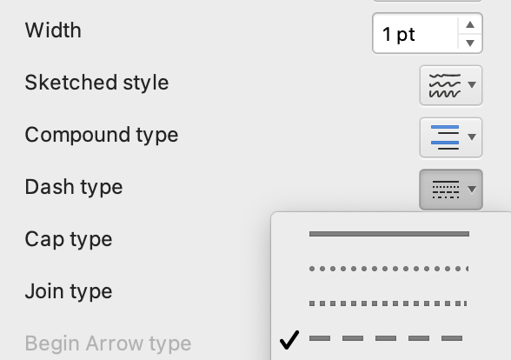
Style: instructions Dashed line
These are the settings to use for creating the various styles. It is recommended to work with the outlined elements and not the filled elements when using these styles in PowerPoint.
Dashed lines are usually used to signify that an element was changed or is passive.
For filled elements, the shape is broken into two separate shapes: one filled, no outline, smaller than the main shape; the second, no fill, with outline dashed at 1.25pt.
Actor
Secondary text
Prescribed node
Without an icon
For outline elements, set the outline as dashed, 1.25pt
Actor
Secondary text
Prescribed node
Secondary text
For elements using a color block under the icons, the outline for the color block needs to stay solid, 1.25pt
IT architecture diagrams kit |

Slide 17
Style: instructions Strikethrough
These are the settings to use for creating the various styles. It is recommended to work with the outlined elements and not the filled elements when using these styles in PowerPoint.
For all elements, a diagonal line, solid, 1pt, is placed on top of the element.
Filled elements use a White line, while outlined elements use a line in the color of the element itself.
Actor
Secondary text
Prescribed node
Without an icon
Actor
Secondary text
Prescribed node
Secondary text
IT architecture diagrams kit |

Slide 18
Connectors
Line styles
Types of connections
Conenctors show relationsips between elements. The default palette in powerpoint is limited, please use other tools if you need more complexity.
solid
dashed 1
dashed 2
double
Element
Line endings
Arrow, open
Element
Arrow, fill
Diamond
Circle
Element
Line weights
1.25pt
2pt
4pt
IT architecture diagrams kit |

Slide 19
Cloud elements library
IT architecture diagrams kit |

Slide 20











Actors
User
Users
Group
Meeting
Administrator
Service
Desk User
User
Collaboration
Devices
Laptop
Mobile
Tablet
Location-
Country
Enterprise
Location

Slide 21








Applications
Application
Automation
Script
Call Application
CLI
Application
Web
Application
Mobile
Application
Virtual Application
API

Slide 22














AI
Governance
Lifecycle
Governance
Tracked
Launch AI
AI
AI
Group
IBM Watsonx
Governance
Machine
Learning
Model
Model
Tuned
Prompt
Session
Prompt
Template
Tuning
IBM Watsonx
IBM Watsonx Data
Serverless
Application

Slide 23























Storage & Data
Database
Data
Backup
Blob
Block
Storage
Block
Volume
File
Storage
File
System
Object
Storage
Object
Bucket
Archive
Data Stax
EnterpriseDB
ElasticDB
ETCD
MongoDB
PostreSQL
RabbitDB
Redis
Block Storage
Application
File Storage
Application
Object Storage
Application
Object Storage
Accessor
Object Storage
Slicestor

Slide 24









































Network
Subnet : ACL
CDN
DNS
Service
Floating IP
Hybrid
Networking
Internet
Message
Queue
Transit
Gateway
Overlay
Network
Load
Balancer
Pool
Unified
Communications
Wifi
Controller
VLAN
Internet
Services
LTE
Transmission
Wifi
Bridge
Voice
Router
Bridge
Router
VPC Load
Balancer
Classic
Load
Balancer
Global
Load
Balancer
Application
Load
Balancer
Network
Load
Balancer
Load
Balancer
Listener
Local
Load
Balancer
Wifi
Router
L2
Switch
L3
Switch
IBM
Subnet: ACL
Proxy
Server
Direct
Link
Load
Balancer
On VPC
VPC
Endpoint
DNS
Server
IBM
VLAN
Network
Interface
Gateway
Public
Gateway
API
Gateway
Mail
Gateway
Edge
Node
IBM
VPC
Public
Network

Slide 25










































Security
Document
Security
Document
protected
Signed document
Document
Protected
Document
unprotected
Fingerprint
recognition
ID management
Credentials
Network admin
control
Security
services
WiFi secure
WiFi
unsecure
VPN policy
Two-factor authentication
VPN
connection
Code signing
service
Policy
Encryption
Password
Locked
Subnet
ACL rules
IBM Cloud
Key Protect
Security
Gateway
Bastion Host
Hardware security module
SIM card
firewall
Session
border
controller
User access
gateway
Gateway
security
Intrusion Prevention
System
VPN
gateway
Data diode
PCN E Node
PCN P node
PCN Z node
Data
Diode
IBM VPC
For VPN
Security
Group
Rule
VPN
Gateway
Certificate
Secrets
Manager
Group
Security

Slide 26










Management
Alerting
Auditing
Call
Manager
IT Service
Management
GUI
Management
Logging
Monitoring
Operational
Chat
Flow
Logs
GUI

Slide 27


























Compute
Image
Service
Chip
Chip
Virtual
Server
Physical
Server
Virtual
Desktop
OpenShift
Kubernetes
Kubernetes
Cluster
Instance Group
Virtual Server
Profile Bx
Virtual Server
Profile Cx
Virtual Server
Profile Mx
Satellite
Satellite
Config.
Satellite
Link
Satellite
Services
Virtual
Server
Classic
IBM Virtual
Server
IBM Bare
Metal
Dedicated
Host
Cloud
Registry
IBM Bare Metal
For VPC

Slide 28








IBM Cloud Paks
IBM Cloud Pak for Application
IBM Cloud Pak for Data
IBM Cloud Pak for Integration
IBM Cloud Pak for Multicloud
Management
IBM Cloud Pak for Network
Automation
IBM Cloud Pak for Security
IBM Cloud Pak for System
IBM Cloud Pak for Watson
AIOps

Slide 29
Create your own Icons
Application &
AI
Storage &
Data
DevOps
Management
Networking
Security
Link to IBM Design UI Icons:
https://www.ibm.com/design/language/iconography/ui-icons/library/
Networking

Slide 30










Groups
Cloud Services
IBM Core: Groups
IBM Cloud: Groups
Enterprise
Data Center
Cloud
IBM Core: Groups: Locations
Point of Presence
IBM Cloud: Groups: Locations
IBM Cloud
Availability zone
Region
Virtual Server
Physical Server
IBM Core: Groups: Compute
IBM Cloud: Groups: Compute
Instance group
IBM Virtual Server
Classic Infrastructure

Slide 31













Groups
IBM Core: Groups: Containers
OpenShift
Public Network
VLAN
VPC
Internet
IBM Core: Groups: Network
Overlay Network
Subnet: ACL
IBM Cloud: Groups: Network
Internet services
VPC Endpoints
IBM Subnet: ACL
IBM Classic VLAN
IBM VPC
Authorization Boundary
IBM Core: Groups: Security
IBM Cloud: Zones: Security
Account group
Security group
Access group
Resource group

